Slide 1

Defeating Ransomware
A threat centric approach to cyber defence
Adam Cartwright
The surest sign that intelligent life exists elsewhere in the universe is that it has never tried to contact us

Slide 2
Defeating ransomware
Agenda
Industry myths
Lessons learnt from cyber defence history
Preventive controls
Turning threats into countermeasures
Response preparation
Questions
Notes:
Adversaries have access to our security stack and test to find ways of circumventing detection.
A security stack, left to itself, will not detect most of the actions performed by an experienced adversary.
Any pen tester or red teamer knows this. This is why tools like cobalt strike exist, and adversaries continuously develop malware to avoid detection.

Slide 3
Defeating ransomware
Myth 1: technology will prevent a breach
LockBit victim June 6 - Adstra - a technology solution company specializing in privacy risks and data management. (US)
If you think technology can solve your security problems, then you don’t understand the problems and you don’t understand the technology.
Bruce Schneier

Slide 4
Defeating ransomware
Myth 2: extortion actors are becoming more sophisticated
Confused messaging.
Notes:
Vendors will give messages like ‘volumes increase because attacks are more sophisticated’, or ‘you should assume breach’
Messaging is blurred by blending high end nations state intrusions with extortion and fraud actors.
But the reality is that extortion actors are not becoming more sophisticated.
The facts are these. Extortion actors gain access through unpatched vulnerabilities that are known. They steal valid credentials. Or they use phishing and web drive byes and all these techniques have been in use for a decade.
Nations state intrusions and extortion intrusions are different, with different resources and different motivations.

Slide 5
Defeating ransomware
Myth 3: compliance = security
“Cybersecurity in the digital age—especially during heightened tension between nation-states—is a tale of two cities. There are organizations that have a culture of security and prioritize protection and reducing risks, and there are organizations with a culture of compliance that do the bare minimum to check the right boxes. A culture of compliance does not lead to effective security, and leadership plays a key role. Choose which city you want to live in wisely.”
Udi Mokady – CyberArk founder
Compliance - Event logs are monitored for signs of compromise and actioned when any signs of compromise are detected.
Notes:
Compliance frameworks often have statements like ‘event logs are monitored for signs of compromise’ but how?
What are you monitoring for?
This is the failing of most compliance frameworks.
Any SIEM or EDR satisfies this generic requirement.
E8 is a basic set of controls to defeat or limit intrusions.
If you have not implemented e8 to a maturity level 2 then you are at increased risk of a breach.

Slide 6
Defeating ransomware
History of cyber defence
History is often ignored in favour of over reliance on technology.
Notes:
Tech continues to seduce and distract from established cyber defence fundamentals.
Attack.Mitre.org was established a decade ago as a result of the Fort Meade Experiment.
The Intrusion kill chain was described by Lockheed Martin in 2011 and built on existing military kill chain theory.
The Diamond Model of intrusion analysis dates to pre-2013.

Slide 7
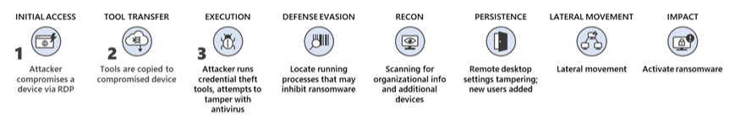
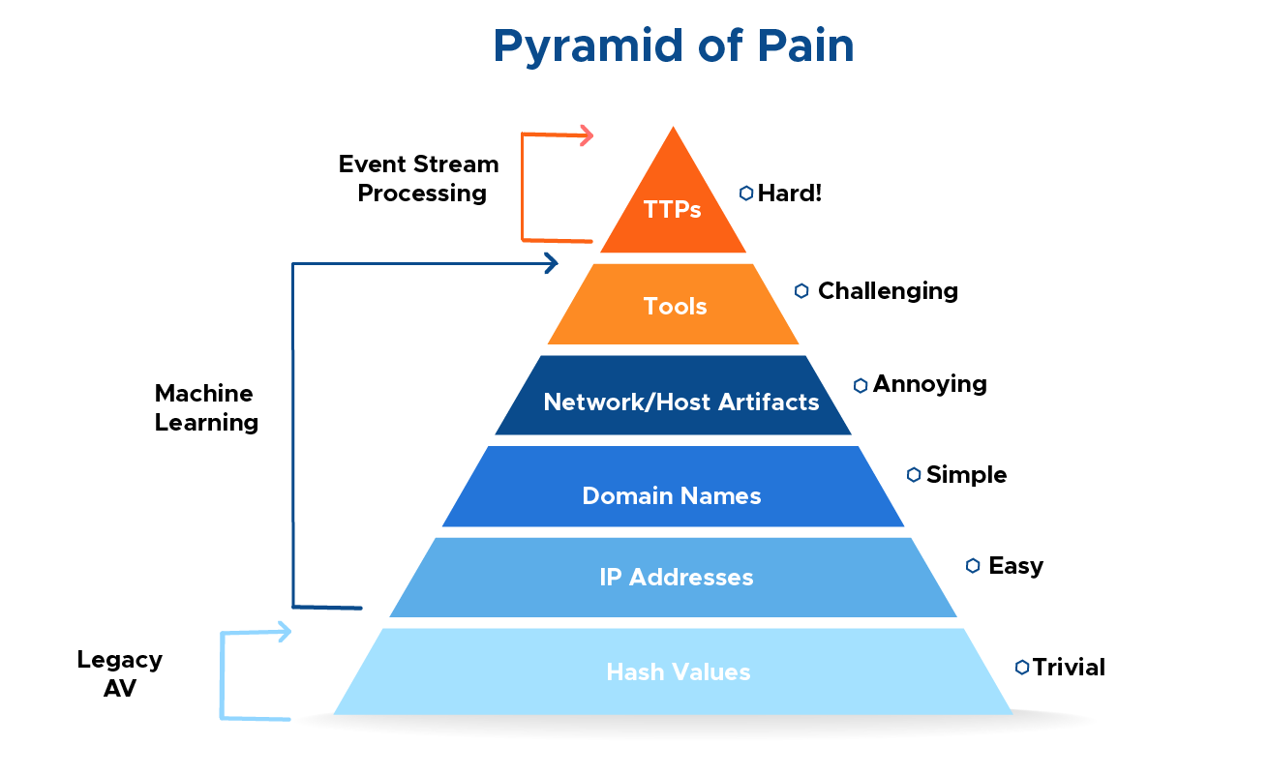
Asahi cyber defence maps the steps taken by attackers during an intrusion. These steps are then intersected with a chain of events with the goal to detect, mitigate and respond to intrusions based on the knowledge of the threat using indicators, patterns and behaviors that are conducted during the course of action of the intrusion.
history
Pyramid of pain
Focus cyber defense on TTP’s in favor of IoC’s
At the apex are TTPs. When you detect and respond at this level, you are operating directly on adversary behaviors, not against their tools. From a pure effectiveness standpoint, this level is your ideal. If you are able to respond to adversary TTPs quickly enough, you force them to do the most time-consuming thing possible: learn new behaviors.” – 2013/David Bianco
IoC’s useful during IR response, less interesting over time due to high rate of change
TTP’s useful during detection, IR for long periods of time.
Limited ways of performing an activity
The threat centric cyber defense approach targets TTP’s, not IoC’s
Notes:
Fight the technique not the IoC.
IoC’s are useful during an incident to identify other potentially compromised assets. Their value decreases with the passage of time.
Techniques have a long lifespan, some spanning multiple years. Detecting or preventing a technique in use by relevant actor should be the goal of the cyber defence team.

Slide 8
history
Repeatability
Key: Extortion techniques are repeated over and over for many years
This is a super critical defence advantage in the fight against Extortion actors
While IoC’s and tools change, the techniques are amazingly consistent. A sampled set of extortion kill chains demonstrated significant correlation between attacks in 2019, 2020, 2021 and 2022.
Reason 1
Reason 2
Reason 3
The use of affiliates and playbooks to execute attacks. RaaS.
Example Conti.
The desire for attackers to introduce as few custom tools into the target environment as possible.
There are multiple ways to discover information while ‘living off the land’ but the number of ways is finite
The small number of eCrime gangs producing ransomware leads to ‘standardization’ of attack patterns. Gangs stick with tried and true.
This means that countermeasures against a technique are very effective for long periods of time.
Notes:
Extortion techniques are repeated over and over against multiple victims across many years.

Slide 9
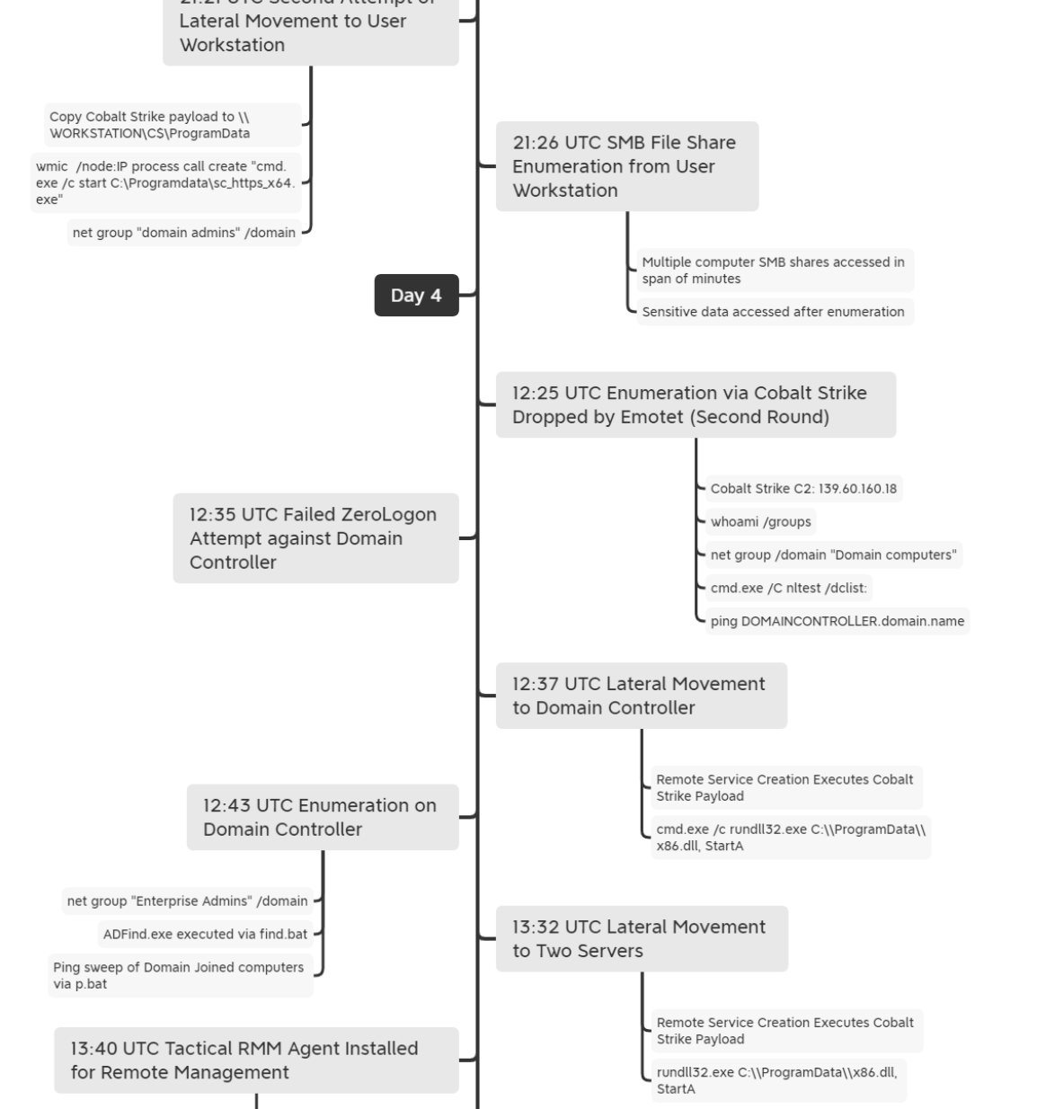
Converged threat specifics
Repeatability example one – actor 1
Example 1: Emotet June 2022
WMIC /node
Rundll32.exe
Net group
Nltest /dclist
Adfind.exe – enumerate AD

Slide 10
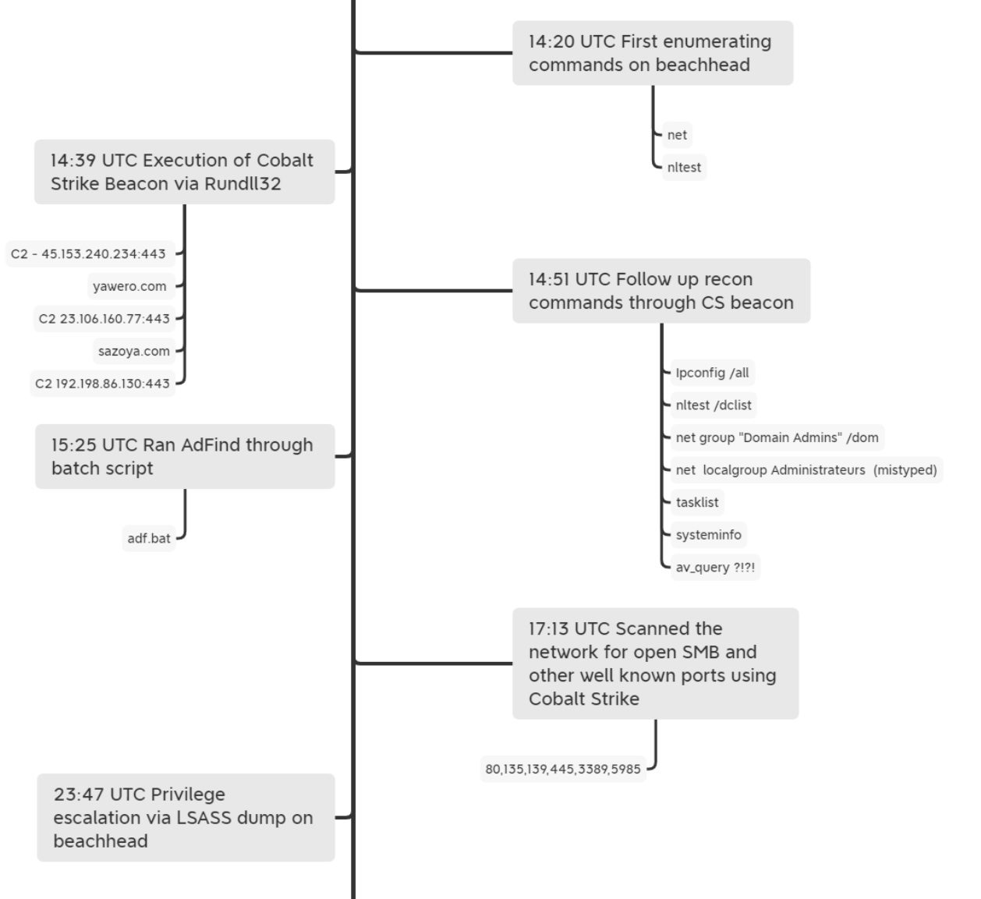
Converged threat specifics
Repeatability example three – actor 3
Example 3: Conti July 2021
Rundll32.exe
Net group
Nltest /dclist
Adfind.exe – enumerate AD
Procdump

Slide 11
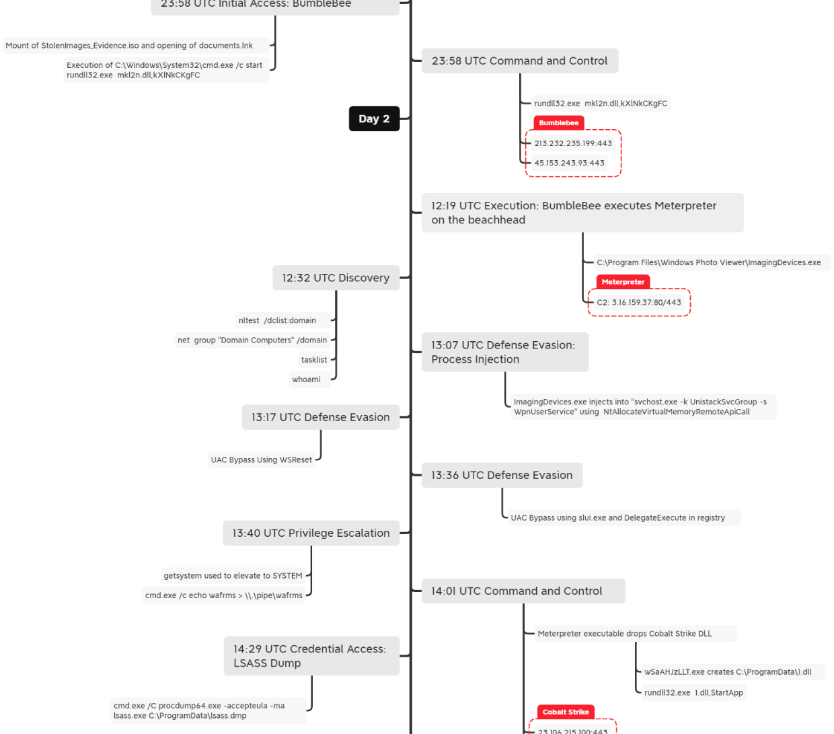
Converged threat specifics
Repeatability example two – actor 2
Example 2: Bumblebee May 2022
Rundll32.exe
Net group
Nltest /dclist
Procdump

Slide 12
Defeating ransomware
Remove the opportunity
Preventive controls
Restrict administrative privileges | Patch operating systems
Multi factor authentication | Application control
Application hardening | Restrict Macros
Patch Applications | Regular backups
Monitor internet footprint | Monitor cloud compliance
Data minimisation | Digital Rights Management
Notes:
Be great at E8. Make sure you have the controls implemented and the coverage tracked.
A build on E8 is make sure you are monitoring your internet footprint and cloud configurations…
Be the first to know if an internet facing vulnerability or unauthorised systems are exposed to the internet.
Additionally make sure you are minimising the personal or sensitive data you are collecting and storing.
If you don’t need it don’t get it.
If you no longer have a need then delete it or tokenise.
It is a regulatory requirement, and it reduces the risk in the event of a breach.
.
Use Digital Rights Management or (DRM) to protect teams that have sensitive documents, especially in transit. It is included in e5. If documents are DRM protected, then they are safe if stolen in a MOVEiT or Accelion type breach.
They are protected no matter where they are much like an iTunes music file.

Slide 13
Defeating ransomware
Pragmatic application
Assurance decisions should not be made by hypothesizing potential adversary's paths but rather by using actual attack paths. This provides more effective protection and increases the adversary cost while reducing the defender's cost.
This is particularly effective against extortion actors who reuse successful attack paths (techniques) against multiple victims.
Notes:
countermeasure development.
This is the operational cycle to inform the implementation of further preventive or detective controls.
This addresses the missing compliance question about defining what we should we be monitoring for.
We can identify actors and identify their techniques,
but the operational challenge has always been how to turn knowledge of techniques into operational outcomes.
In 2019 Red Canary published an open-source library of tests for every technique and they maintain this library on Github.
This is one way to fill the gap between knowing the technique and developing countermeasures in a consistent, operational way.
We now have the actors, techniques, and associated tests we can use to identity security gaps and develop countermeasures.

Slide 14








Background
Operational threat process
2
OSINT
Techniques
Divergent
Convergent
3
eCrime
Commodity
1
Operational
Threat process
Actors
Strategic interest
Country
Sector
Atomic tests
Fraud
Validation
Relevance
4
Nation State
Activist
Countermeasures
Protective
Detective
Notes:
Pragmatically, turning threat insights into something actionable looks like this.
Start by understanding your organisation and its potential interest to different adversary types.
Consider your organisations level of strategic interest, industry sector and geographic location.
Might also consider political agendas, potential ideology conflicts, whom you do business with.
Converge from a broad threat view to specific adversaries of interest.
The adversary groups relevant to your organisation will allow you to map the techniques in use.
Mitre, DFIR, other intel sources all list the Techniques.
Most modern intel reports also map observed techniques at the end of the report.
Then map the list of techniques to the Atomic tests from Red Canary and test your ability to block or detect the technique.
You will soon find that your security stack fails to prevent a significant number of the tests.
For those that fail, check to see if you can put a preventive control in place or write detection logic for your SIEM to alert the SOC. Repeat.
It is the lack of this robust threat to countermeasure cycle that is leading to a proliferation of breaches.
This should form part of an iterative monthly operations lifecycle.
Organisations should be able to demonstrate the backlog of countermeasures proposed for development.

Slide 15


2023 Threat Actors
Action | TTP
Email: Block ISO files. Web: Block ISO files except for approved sites. Email: Block OneNote files *.ONE | T1204.002, #10
Alert on MOUNT from a user directory | T1553.005
Prevent RCLONE.EXE from executing or alert on execution | T1105, T1048.003
Detect command line with DLLRegisterServer. Rundll32.exe is being renamed to avoid detection | T1218.11
Block Office MACRO execution. Spearphishing JOB applications and recruitment forms. Stop Office applications from creating ps1, vbs and executing. | T1566, T1566.001, T1204.002
Alert on PowerShell -Invoke-Sharefinder for common SMB discovery | T1135
Alert on UserAgent strings using outdated Chrome version (Mozilla/5.0 (Windows NT %d.%d; %s) AppleWebKit/537.36 (KHTML, like Gecko) Chrome/87.0.4280.66 Safari/537.36) | T1071.001 (modify test to reflect supplied string)
The ransomware actors relevant to Australian business has changed.
GOLD SOUTHFIELD (Revil) has largely been dismantled.
WZARD SPIDER (FIN12 / Conti) has splintered into smaller units that include Royal, Hive, Quantum and BlackCat RaaS.
However, the techniques mapped to these crime groups are still relevant as the splinter groups leverage existing IP and playbooks.
With the RaaS services becoming normalized the volume of attacks is increasing. There are more IAB and affiliates being observed as the ecosystem expands.
Notes:
In 2023 ransomware groups changed. We are hearing Lockbit, BlackCat, AlphV and Royal rather than Conti, REvil and Hive.
What is key to understand is that the new groups are mostly formed from the splintering of the previous actors.
They take with them the techniques and code base and introduce some variations.
The techniques stay relevant, and persistent.

Slide 16
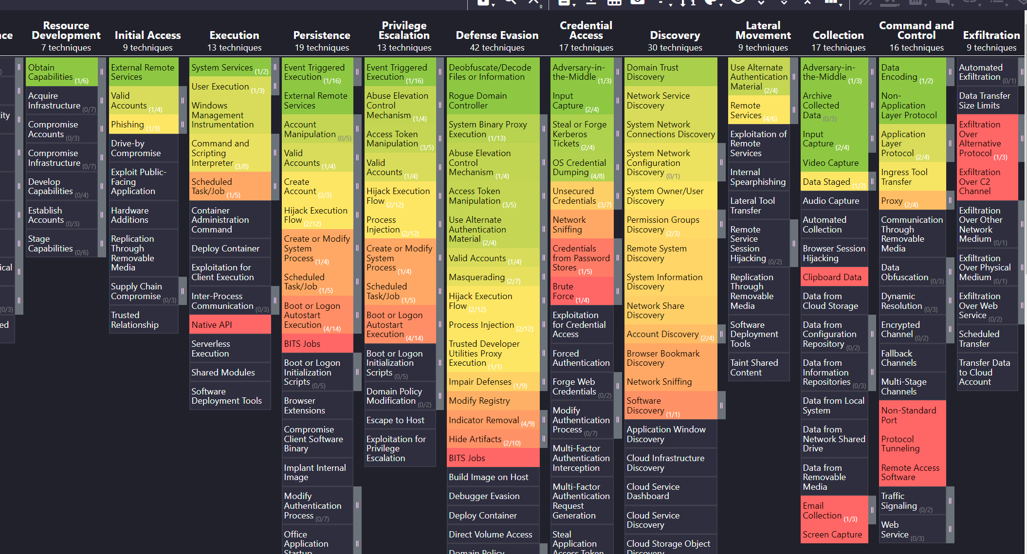
Monitoring progress
Mitre ATT&CK Navigator
Notes:
Ultimately, the intent is to gain an understanding of where your security weaknesses lie.
This is a snapshot of the Mitre Attack navigator tool that is also free.
Techniques with no colour indicate that technique is not is use by the extortion actors identified.
The greener the technique the more atomic tests were successfully prevented or detected by the SOC.
The more red the more the tests went undetected and these should inform the countermeasure backlog.

Slide 17
Defeating ransomware
Ransomware response preparation.
Hope for the best, plan for the worst…
Progressive Containment
Restoration immutability and permissions
Out of band communications
Practice -Cyber drills
IR at scale
Notes:
Progressive Containment.
Organisation are dependent on internet SaaS, AAD, o365, EDI.
Pre-define firewall policies that escalate containment from partial to complete internet isolation.
It is much easier to define policies now rather than when you are in the chaos of IR.
The idea is to try and keep business critical applications operating while disrupting C2.
Obtain executive pre-approval for Authority to Act delegation in relation to isolating internet for containment.
There have been examples where delays in establishing crisis committees and approvals have worsened an intrusion significantly.
Now is the time to revisit your backup capability.
Are the backups immutable,
can they be accessed if the AD is compromised, who has permissions to alter and delete?
Do the backups allow rolling back to any time within the last 90 days?
Establish an out of band comms strategy. If email is down how will you coordinate response? Think about using an alternate tenancy or setting up call trees.
Practice – involve ELT and do separate technical sessions. Take an existing breach in the media and use it as the basis for the drill.
Communications should be pre-planned
Will you pay a ransom.
What is the priority for system restoration?
How will you maintain IR and forensics at scale for an extended period. Most MSSP’s do not have this in their contract – retainer to secure resources?

Slide 18
Defeating ransomware
Summary
Preventive controls – Essential Eight and builds
Understanding threats and implementing countermeasures
Data minimization and Digital Rights Management
Preparing and testing response

Slide 19
Resources
Information on Groups, Software and Techniques
https://attack.mitre.org/tactics/enterprise/
https://mitre-attack.github.io/attack-navigator/
Information on recent, detailed attack chains
https://thedfirreport.com/
Detailed, atomic tests for each technique
https://github.com/redcanaryco/atomic-red-team/tree/master/atomics
https://redcanary.com
Key terms:
Technique Observable action or behavior
Test Atomic test from Red Canary, or other source
Countermeasure A defensive action to prevent or detect the technique
There is no specific investment needed beyond time to implement this threat centric approach.
All data and tools used are available open source.

Slide 20
Defeating ransomware
Questions

