Slide 1
Abnormal Security
Complex Problems, Abnormal Solutions.
CISO Melbourne
Tim Bentley, Regional Director APAC

Slide 2
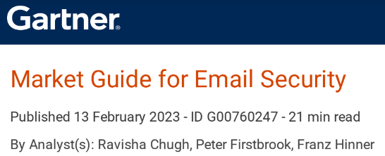
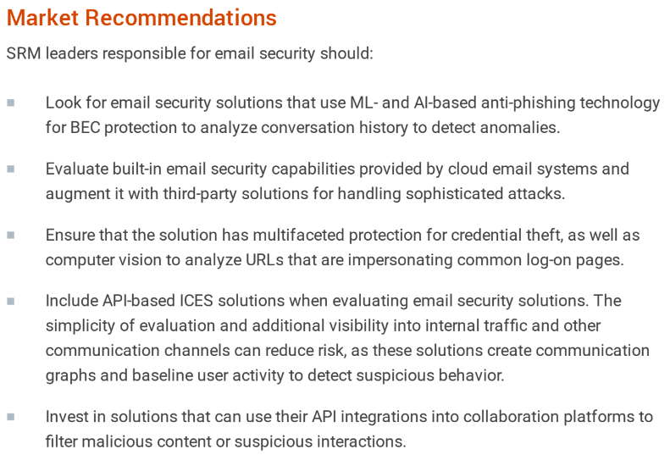
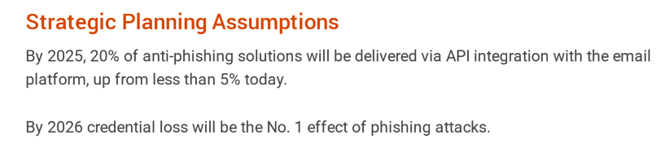

- AI and ML
- API based
- Mass adoption of APIs
- Continued growth of credential phish
- Parity between MSFT and SEGs

Slide 3
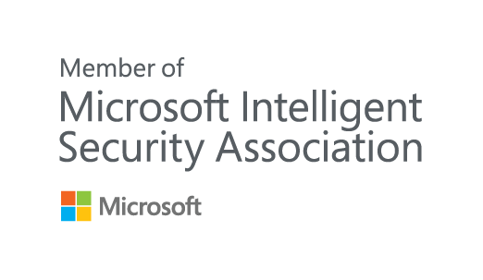


Microsoft recommend Abnormal Security
“Abnormal Security augments native Microsoft security services (Azure Sentinel, Defender for Office 365) to protect our mutual customers from advanced socially-engineered attacks while also reducing security stack complexity and improving SOC efficiency”
Member Of The Microsoft Intelligent Security Association
The Microsoft Intelligent Security Association (MISA) is an ecosystem of independent software vendors and managed security service providers that have integrated their solutions to better defend against a world of increasing threats. MISA members are top experts from across the cybersecurity industry with the shared goal of improving customer security.
Microsoft Preferred Solution
Preferred solutions are selected by a team of Microsoft experts and are published by Microsoft partners with deep, proven expertise and capabilities to address specific customer needs in a category, industry, or industry vertical.
Member Of The Microsoft AI Inner Circle Partner Program
The AI Inner Circle Partner program is designed for partners who provide custom services or enhanced AI product solutions utilizing Microsoft AI technologies. This program recognizes a partner's unique expertise in specific industries and their ability to drive business transformation using the power of AI and data.
abnormalsecurity.com/microsoft-partnership
‹#›

Slide 4
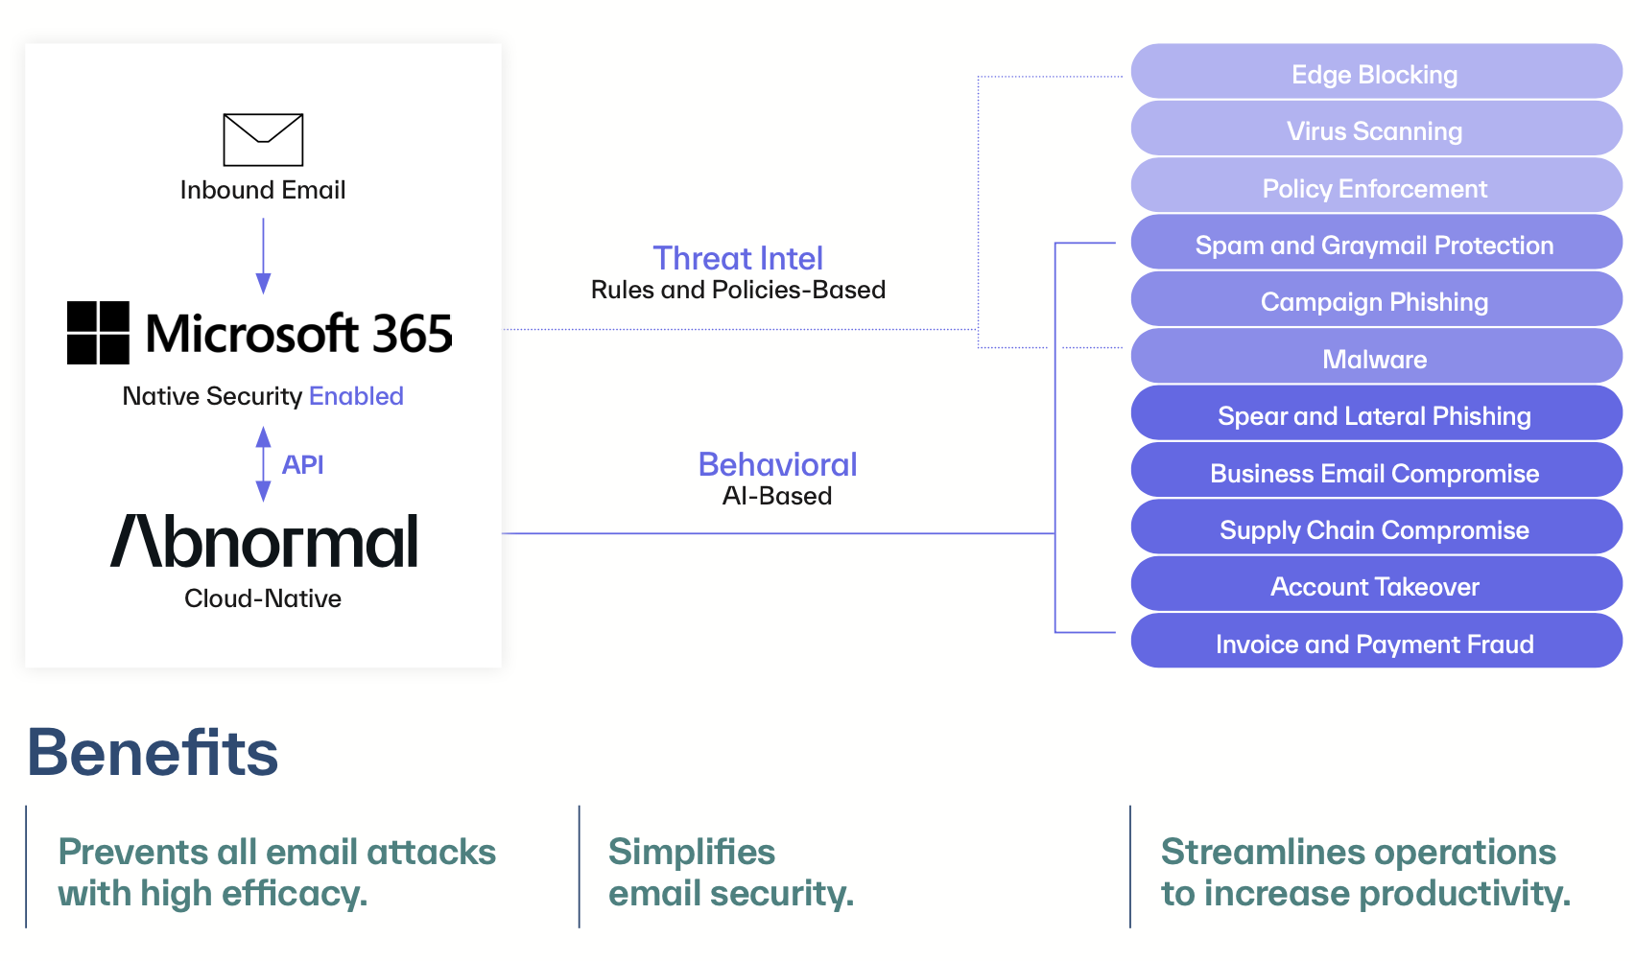
Working in harmony with Microsoft, or Google

Slide 5
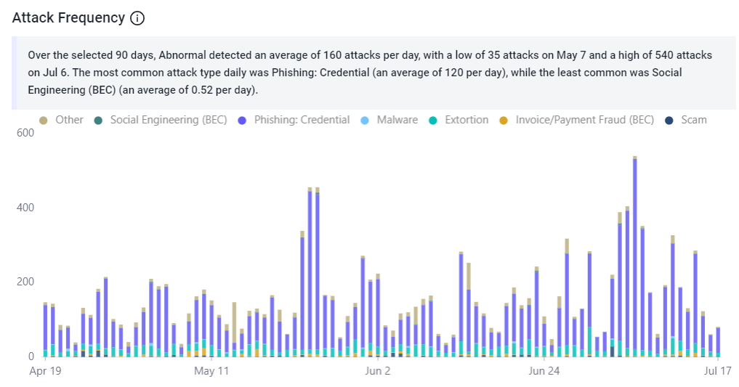
Australian Media - attacks missed by SEG
‹#›

